Slide 1
A Smart Payload System for Use in Industrial Settings
April 2, 2012 Progress Update
Edward Venator
EECS 600
Case Western Reserve University

Slide 2
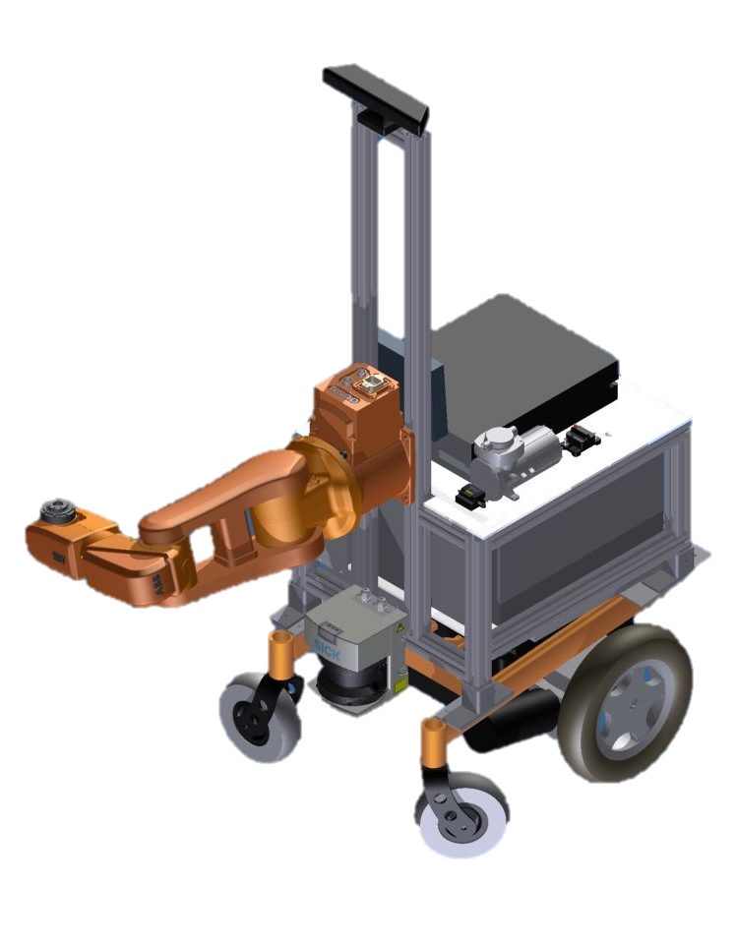
Purpose
Mobile manipulators in industrial settings can benefit from information about the objects they manipulate.
This information can come from a database, from tags on the objects themselves, or learned from experience with objects.
Notes:
My Masters thesis concerns the construction of a mobile manipulator consisting of an ABB IRB-120 robotic arm mounted on a mobile based originally designed for an electric wheelchair.
The ultimate purpose of this robot is to perform “kitting” operations in a factory environment. The robot must retrieve combinations of items from inventory and deliver them to stations on an assembly line.
In a factory environment, it is possible to catalog manipulable objects into a database. That database can hold a wealth of information about the objects, and the information can be retrieved via object tags such as QR codes, bar codes, or RFID tags.
By standardizing this information, it would be possible to “commoditize” manipulable object data. Items that come in the same box wouldn’t have to be separately modeled for robotic manipulation, but could simply be tweaked for properties like mass. Since so many packages are already tagged with barcodes or RFID tags, most packages would require little alteration.
The question is:
What information should be included?

Slide 3
Project Objectives
Determine the state of the art in smart payload systems.
Determine what object data is most useful for manipulation.
Demonstrate an example of a smart payload object that can provide useful information to a mobile manipulator.
Notes:
There’s a lot of research on how a robot can find or recognize objects in an environment, but not a lot on how to help facilitate that. The holy grail of robotics research has been a general purpose “household” robot. Meanwhile, we still don’t have a general purpose industrial robot. We have robotic arms, and we have robotic fork lifts, but we don’t have something that can go grab two pipes and a fitting unless you tell it explicitly where they are and how to grab them.
To accomplish this project, I first need to determine exactly what the state of the art is in this field. As far as I can tell, most of the explorations have been directed toward general purpose object recognition and manipulation, but the results can be applied to this problem, which I’ll discuss later.
From that existing research, I plan to decide what properties are most salient to a mobile industrial manipulator – things like grasp affordances, mass, volumetric data, visual cues for registration.
In order to provide this data to a robot, it must be stored in a database and retrieved on demand. In an industrial environment, this is accomplished by a complex inventory management system that performs many other duties such as supply chain management. In my case, I’ll be using a simple database in its place.
By the end of this project, I plan to demonstrate a basic but extensible system that can store and serve information about at least one object.

Slide 4
Methods
Continue reviewing manipulation literature.
Examine manipulation algorithms and determine a workflow for a robot performing kitting for assembly in an industrial environment.
Evaluate candidate properties for encoding based on criteria such as usefulness for manipulation, data density, and computational complexity.
Based on the high level algorithms and workflow, design a prototype smart payload object show conceptually how a robot can interact with it.
Notes:
This project begins with a literature review of grasping and manipulation in general, and any research that may exist on smart payloads. In my reading so far, I’ve found a lot about identifying and grasping objects with no a priori knowledge of the object and with complete a priori knowledge of the object, but in both cases, the object was unlabeled. I’d like to do a bit more research to see if anything has been done with this, but I think this is a different approach to the problem.
I’ll be evaluating different types of manipulation data based on how useful they are to a manipulator, how much information can be transmitted in how much data – a full CAD model contains a lot of information, but it’s all a lot of data, whereas a simpler representation of an object might be more efficient. Where possible, I’d like to reduce the computation that the robot needs to do. If something can be precomputed without losing generality, it should be.
In order to evaluate different properties and see how they fit into an overall control scheme, I’ll have to prototype software for high-level control.
Using the software and algorithms I develop, I should be able to simulate high level planning, and from there I can see how different planning schemes that depend on different smart payload data perform. Ultimately, I can decide what information smart payloads should give the robot.

Slide 5
Progress
Refined project goals and methods
Continued studying existing literature on object recognition, grasp choice, and affordances
Started looking at a possible workflow for this type of robot

Slide 6
Basic Workflow
Describe
Object(s) (Instrinsic)
Location(s) (Extrinsic)
Locate/Identify
Learn
Improve knowledge of object
Improve knowledge of object location
Confirm object identity based on properties
Find object based on location information
Manipulate Object
Pick up object
Store object on robot
Next Object

